Slide 1
OUTLINE OF PRESENTATION
Problem Statement
Objectives
Working
Result
Conclusion

Slide 2
Secure Data Transmission Using Quantum Key
Distribution (QKD) Based on the BB84 Protocol
PROBLEM STATEMENT
Traditional cryptographic systems are vulnerable to cyber-attacks and future quantum computers.Secure key exchange is difficult because classical channels can be intercepted without detection.Quantum Key Distribution (QKD) uses photon-based qubits that reveal any eavesdropping attempt.There is a need to simulate and analyze a BB84-based QKD system for secure key generation.The project aims to ensure secure data transmission using QKD over hybrid quantum channels.

Slide 3
Secure Data Transmission Using Quantum Key
Distribution (QKD) Based on the BB84Protocol
OBJECTIVES
To design a Quantum Key Distribution (QKD) framework based on the BB84 protocol for secure key exchange.
To simulate photon-based quantum states, key generation, and key sifting using quantum simulation tools.
To detect eavesdropping attempts by analyzing Quantum Bit Error Rate (QBER) in the quantum channel.
To integrate the generated quantum keys with classical symmetric encryption (e.g., AES) for secure communication.
To evaluate the performance of QKD over hybrid quantum channels (fiber and free-space) for improved security and accuracy

Slide 4
Secure Data Transmission Using Quantum Key
Distribution (QKD) Based on the BB84Protocol
Working
Quantum Key Generation (Alice):
Alice gets the qubits ready by using two types of bases — rectilinear (+) and diagonal (×). She then puts random bits (0s and 1s) into these qubits by setting the photons’ polarization according to the BB84 protocol..
Quantum Transmission:
The encoded qubits travel through a mixed (hybrid) quantum channel. First, they move through an optical fiber to a relay. After that, they are sent through a free-space optical link to reach Bob.
Relay Node Operation:
The relay gets the qubits, reads or decodes them, creates new qubits with the same information, and sends them forward. This helps the quantum key travel safely over a longer distance..
Key Reception & Sifting (Bob):
Bob measures the received photons using randomly chosen bases. Alice and Bob later compare their bases over a classical channel and keep only the matching ones to form the raw key.
Error Detection & Privacy Amplification:
They calculate the Quantum Bit Error Rate (QBER) to detect any eavesdropping. If QBER is acceptable, error correction and privacy amplification are applied to produce the final secure key.

Slide 5
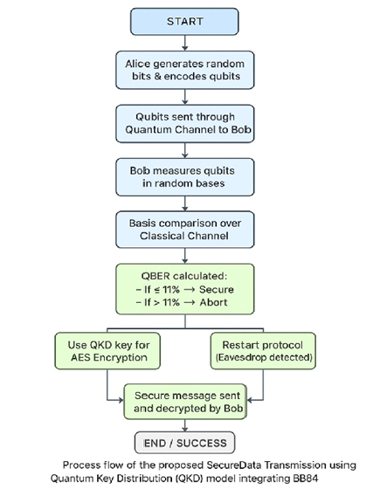
Secure Data Transmission Using Quantum Key
Distribution (QKD) Based on the BB84Protocol
FLOWCHART

Slide 6
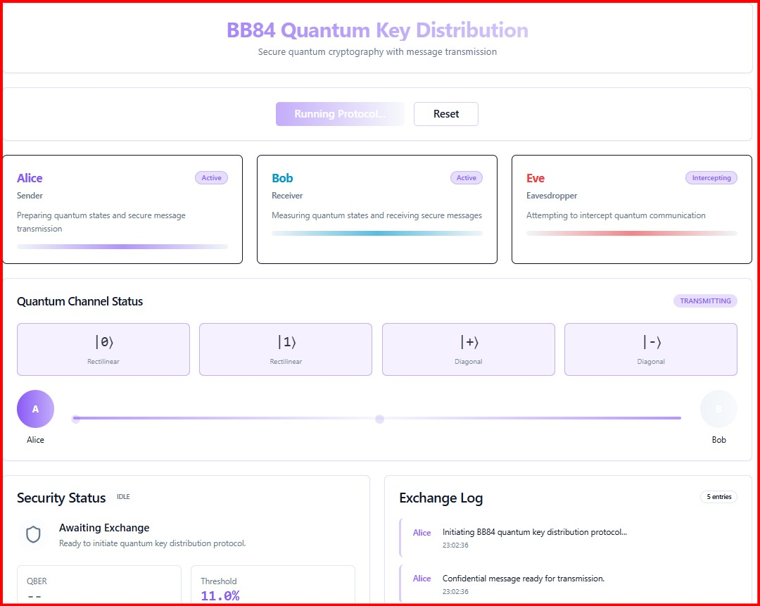
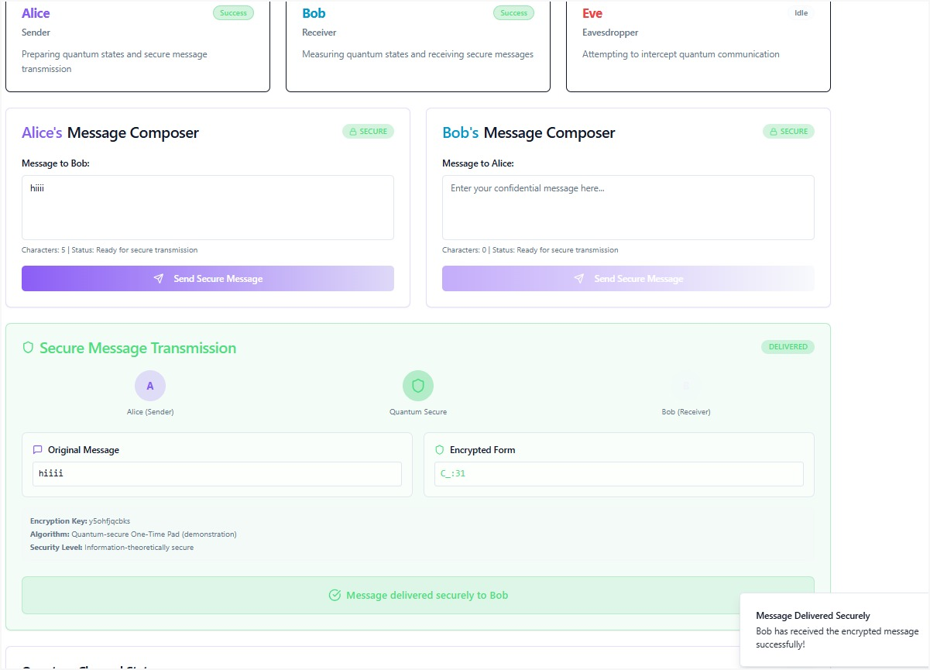
Design And Development of
Automated Penetration Testing Tool
RESULTS

Slide 7
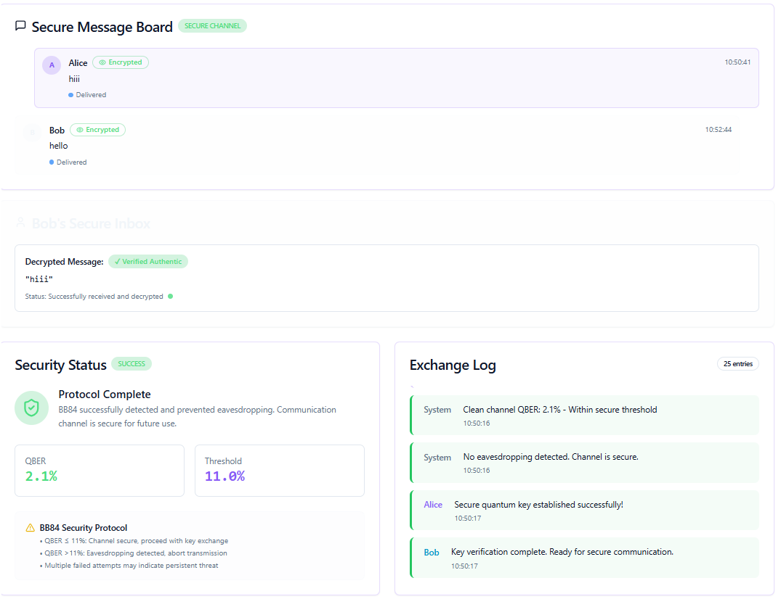
Design And Development of
Automated Penetration Testing Tool
RESULTS

Slide 8
Secure Data Transmission Using Quantum Key
Distribution (QKD) Based on the BB84Protocol
CONCLUSION
The project successfully demonstrates that Quantum Key Distribution (QKD) using the BB84 protocol provides a highly secure method for key exchange by leveraging the fundamental principles of quantum mechanics. By simulating hybrid quantum channels (fiber and free-space), the system effectively detects eavesdropping through QBER analysis and ensures that only error-free, privacy-amplified keys are used. Integrating these quantum-generated keys with classical encryption like AES further enhances data confidentiality. Overall, the implementation proves that QKD is a practical and future-ready solution for secure communication against both current and upcoming quantum-based cyber threats.

